Slide 1
The Procrastinators
Nathan Knight, Harrison Yuan, Gwendolyn Hammons, David Feng, Kate Baldwin, Nickolas Bruce

Slide 2
Motivation
Our team wanted to explore the effectiveness and limitations of Bluetooth technology through a simple, fun and engaging project of designing a remote controlled car.
Notes:
Gwen

Slide 3
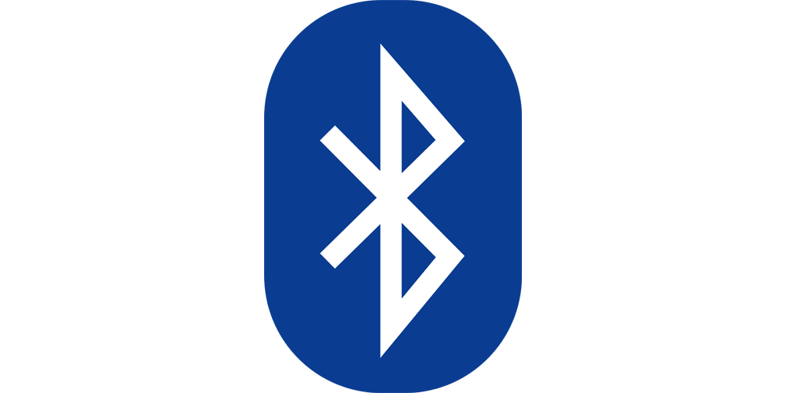
Theory
Bluetooth is used in many devices such as cars, cellphones, headsets and computers.
The bluetooth symbol are the letters H and B
in Viking runes, the initials of Herald Bluetooth.
Bluetooth uses an RF transceiver (physical layer) and operates in the unlicensed ISM band at 2.4 gigahertz. Utilizing hopping to combat both interference and fading.
Notes:
kate

Slide 4
Theory
Frequency hopping spreads the signal over rapidly changing frequencies. The band is divided into sub frequencies and the signal rapidly hops among the bands in a predetermined order.
This hopping is one of the main reasons the technology was initially researched. It was deemed as a secret communication signal and was developed by the military because it could not be jammed by an enemy.
Notes:
kate

Slide 5
Functionality
Our device has a few key features:
Bluetooth connectivity
Android application to communicate with our car
2 motors on our car work in coordination to perform 4 basic functions:
Move Forward
Move Backwards
Turn to the Right
Turn to the Left
Flashing lights (blue and red) as well a buzzer
Notes:
Gwen
Reference: How we chose the parts
Originally we had the uno and the stepper motors but the difficulty in finding wheels as well as the slow speed led to us deciding to use a car kit. This came with a chassis, wheels, DC motors, as well as range finders which we found out we did not need.

Slide 6
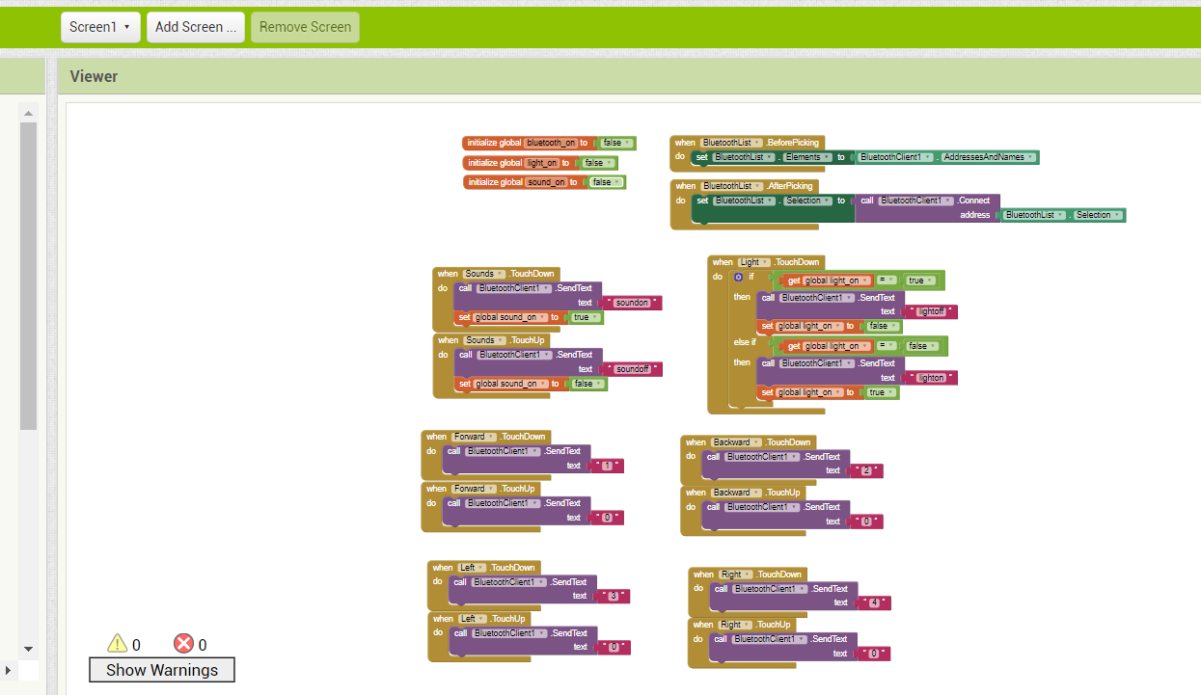
Bluetooth App
Bluetooth car controller is developed using MIT App Inventor
Basic four direction car movement controls implemented. Additional features such as lights and speakers have been coded into the app as well, which could be added to the car for future reference.
Display of the block design coding scheme to send out bluetooth signals based on buttons pressed.
Notes:
Harrison

Slide 7
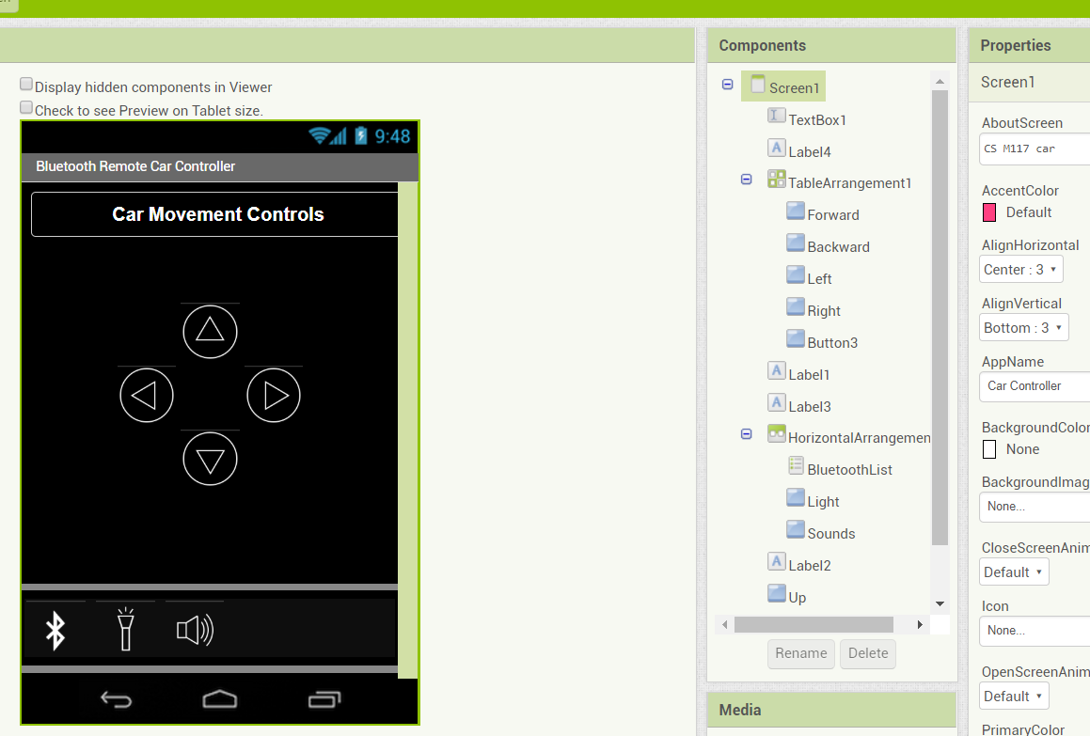
Remote Car Controller
Clean minimalistic buttons with icons designed from scratch in paint.NET
Searches for all available bluetooth connections and sends basic commands for arduino controller in the car to interpret
Design interface of the basic controller app with additional button commands that were implemented for extra functionality
Notes:
Harrison

Slide 8
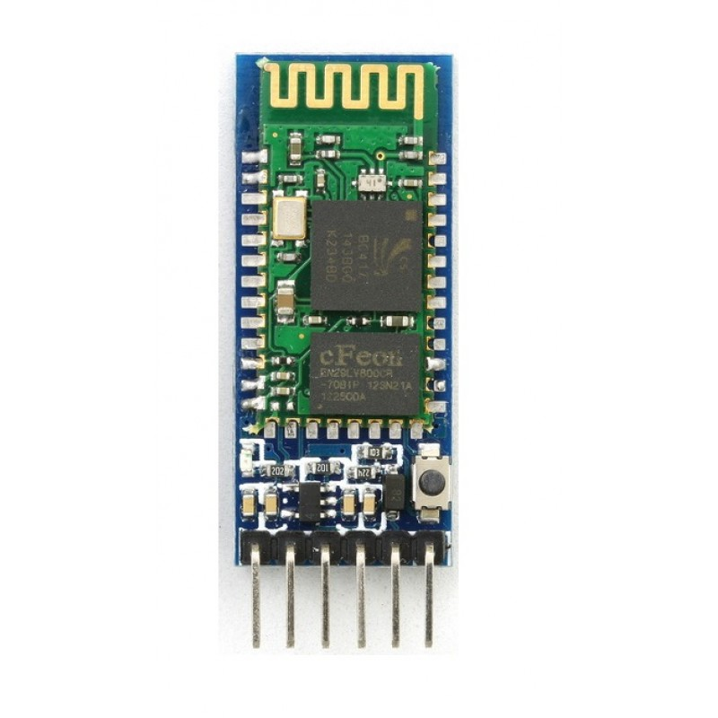
Bluetooth Module
Used the Bluetooth HC05 (pictured here)
Intentionally limited to one hardware to better focus on research
Notes:
Nick

Slide 9
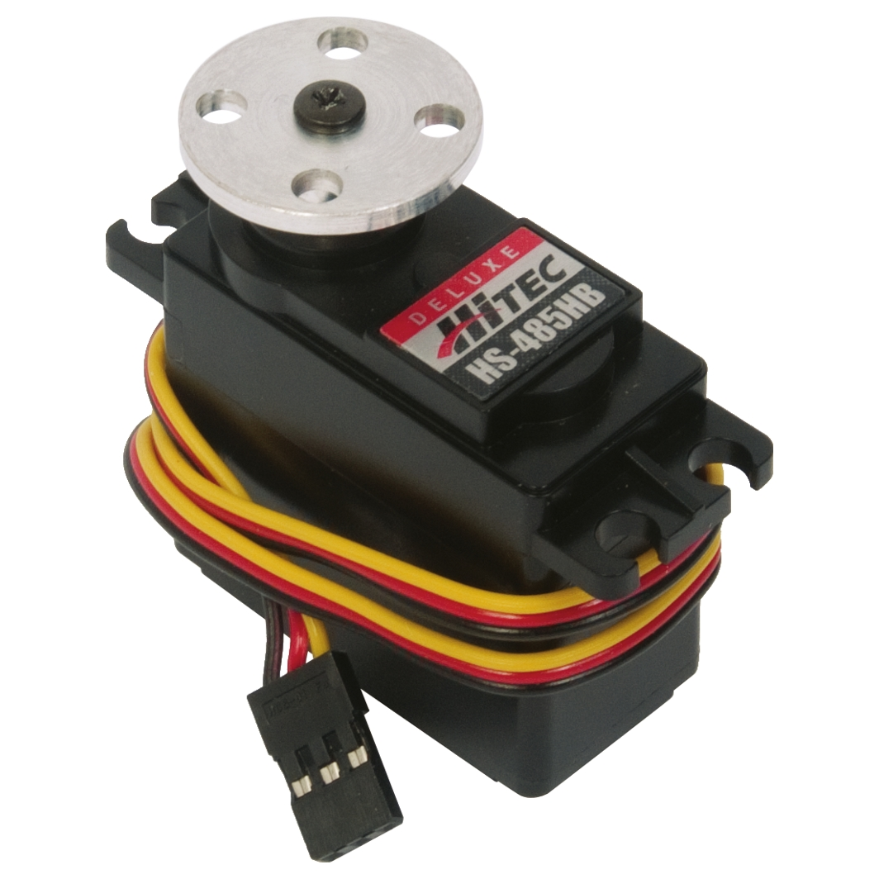
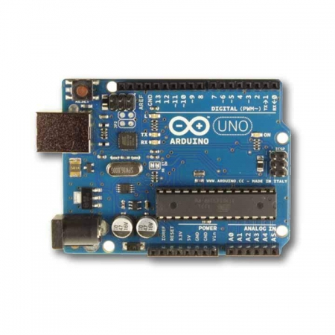
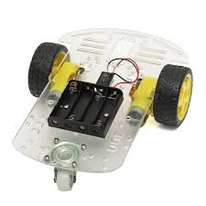
Vehicle Assembly
2 DC Servo Motors
Arduino Mega
Bluetooth HC05
Wheels
Chassis
Notes:
David

Slide 10
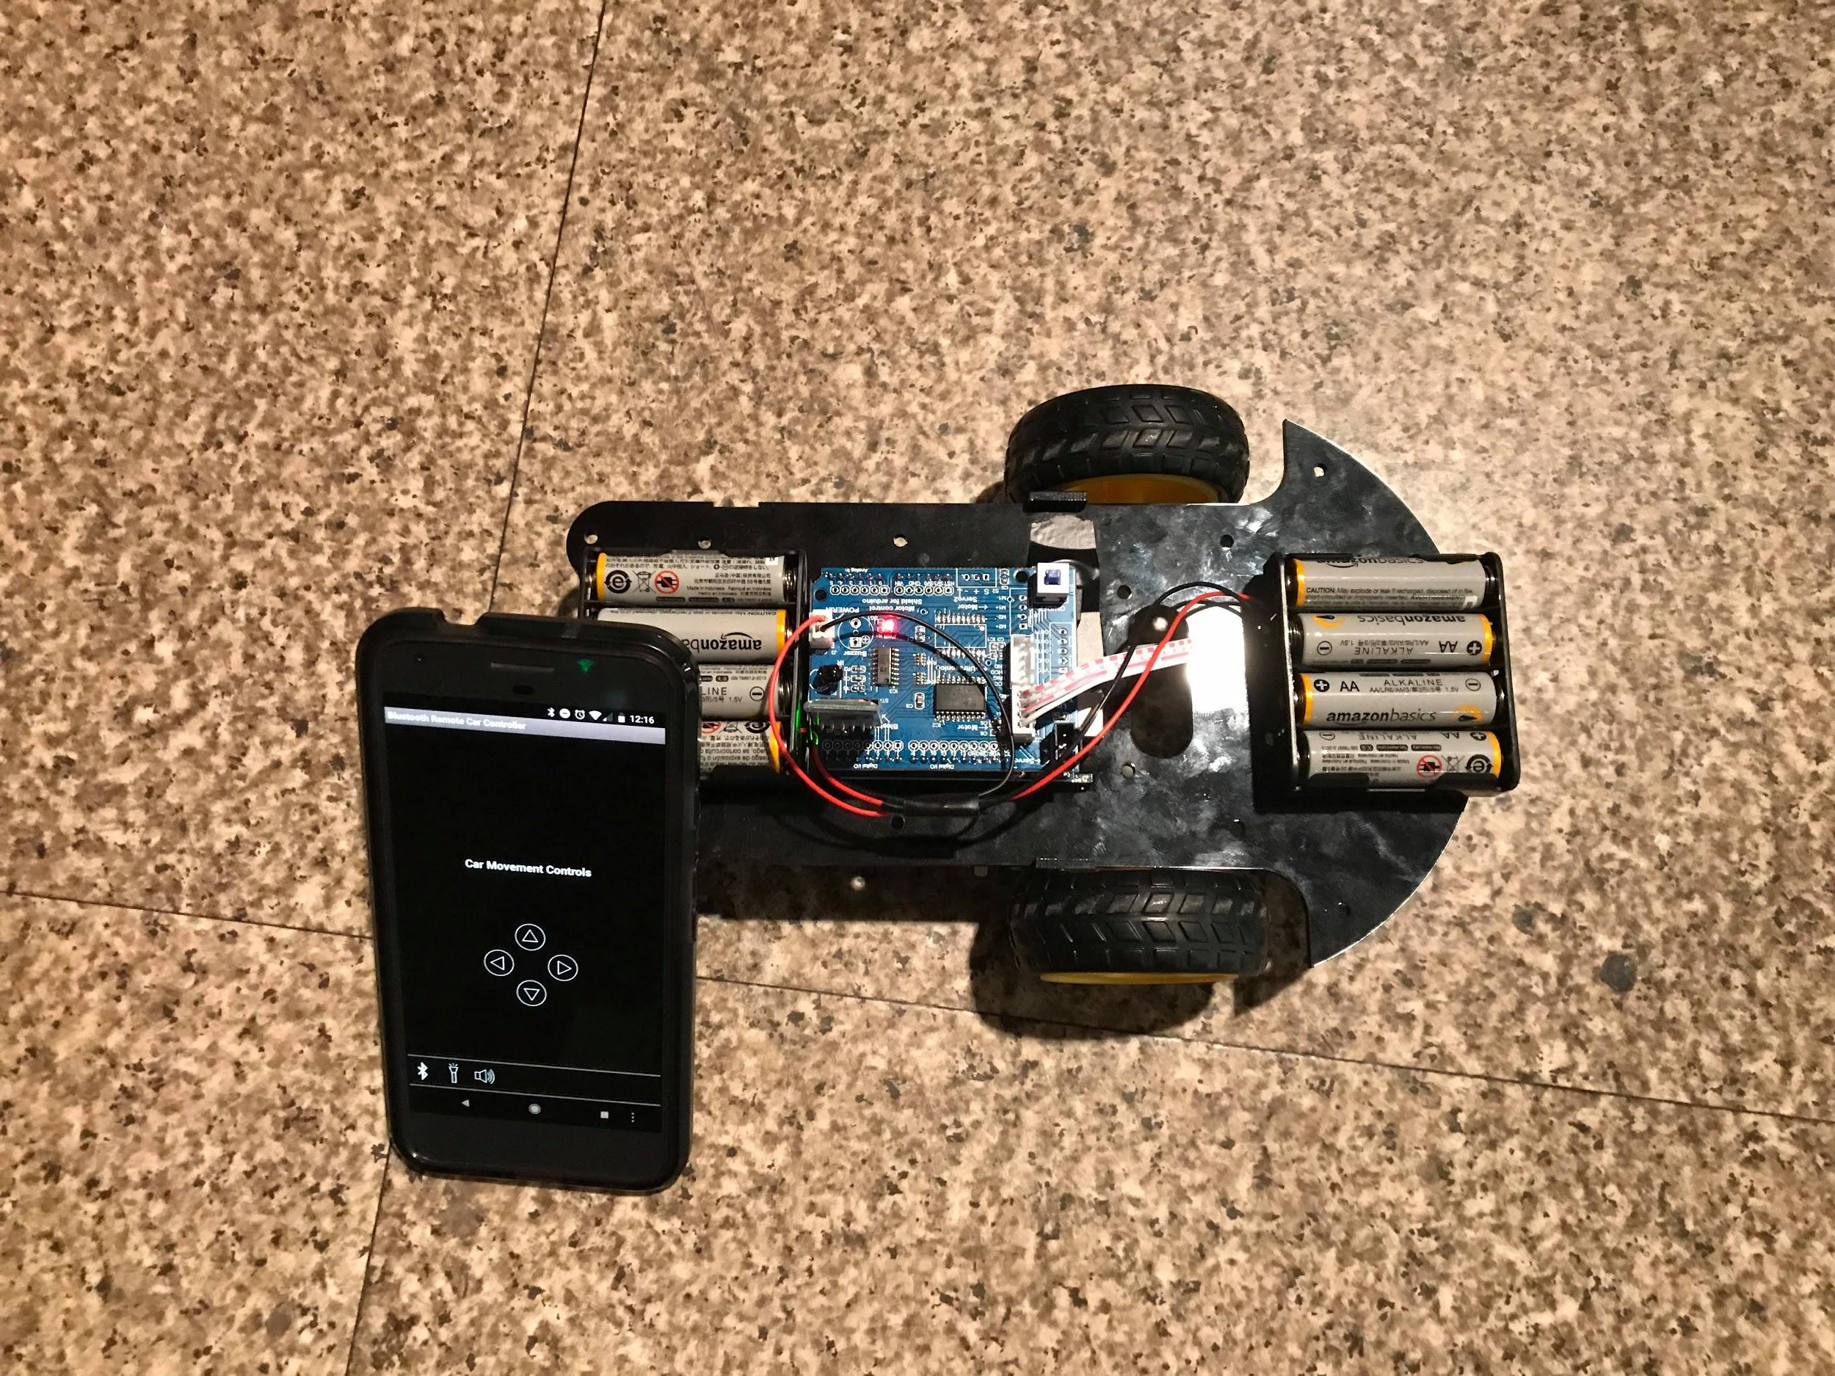
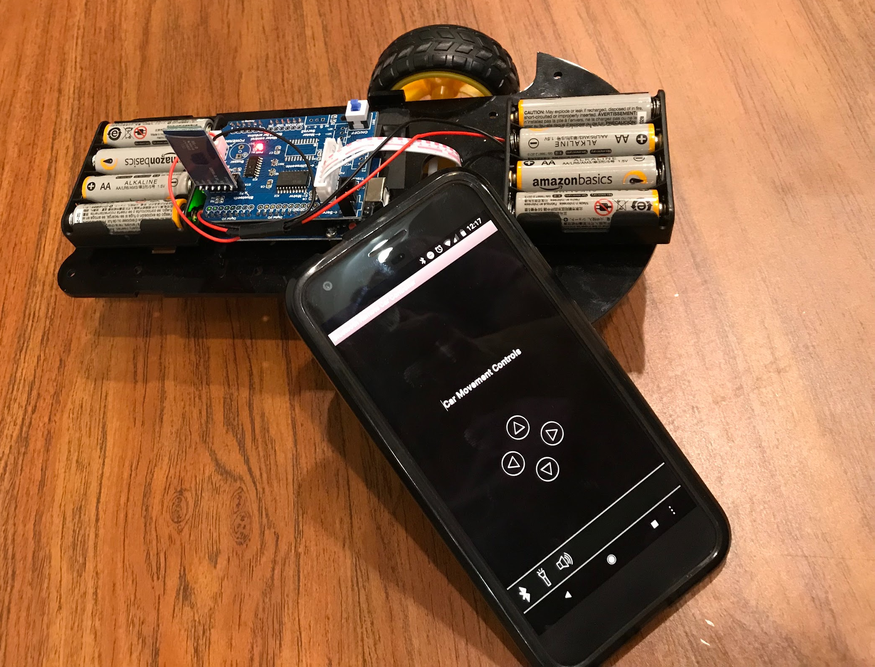
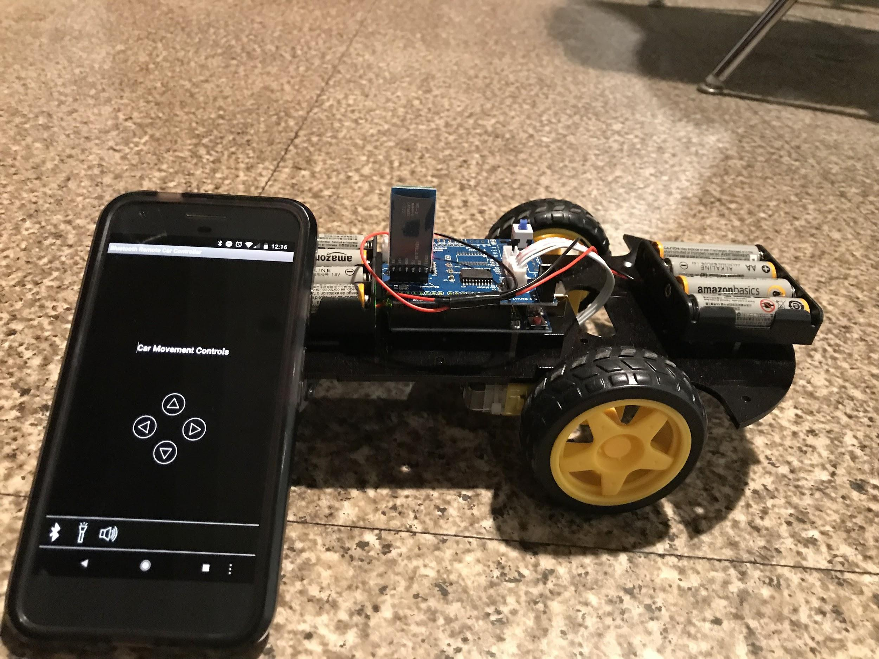
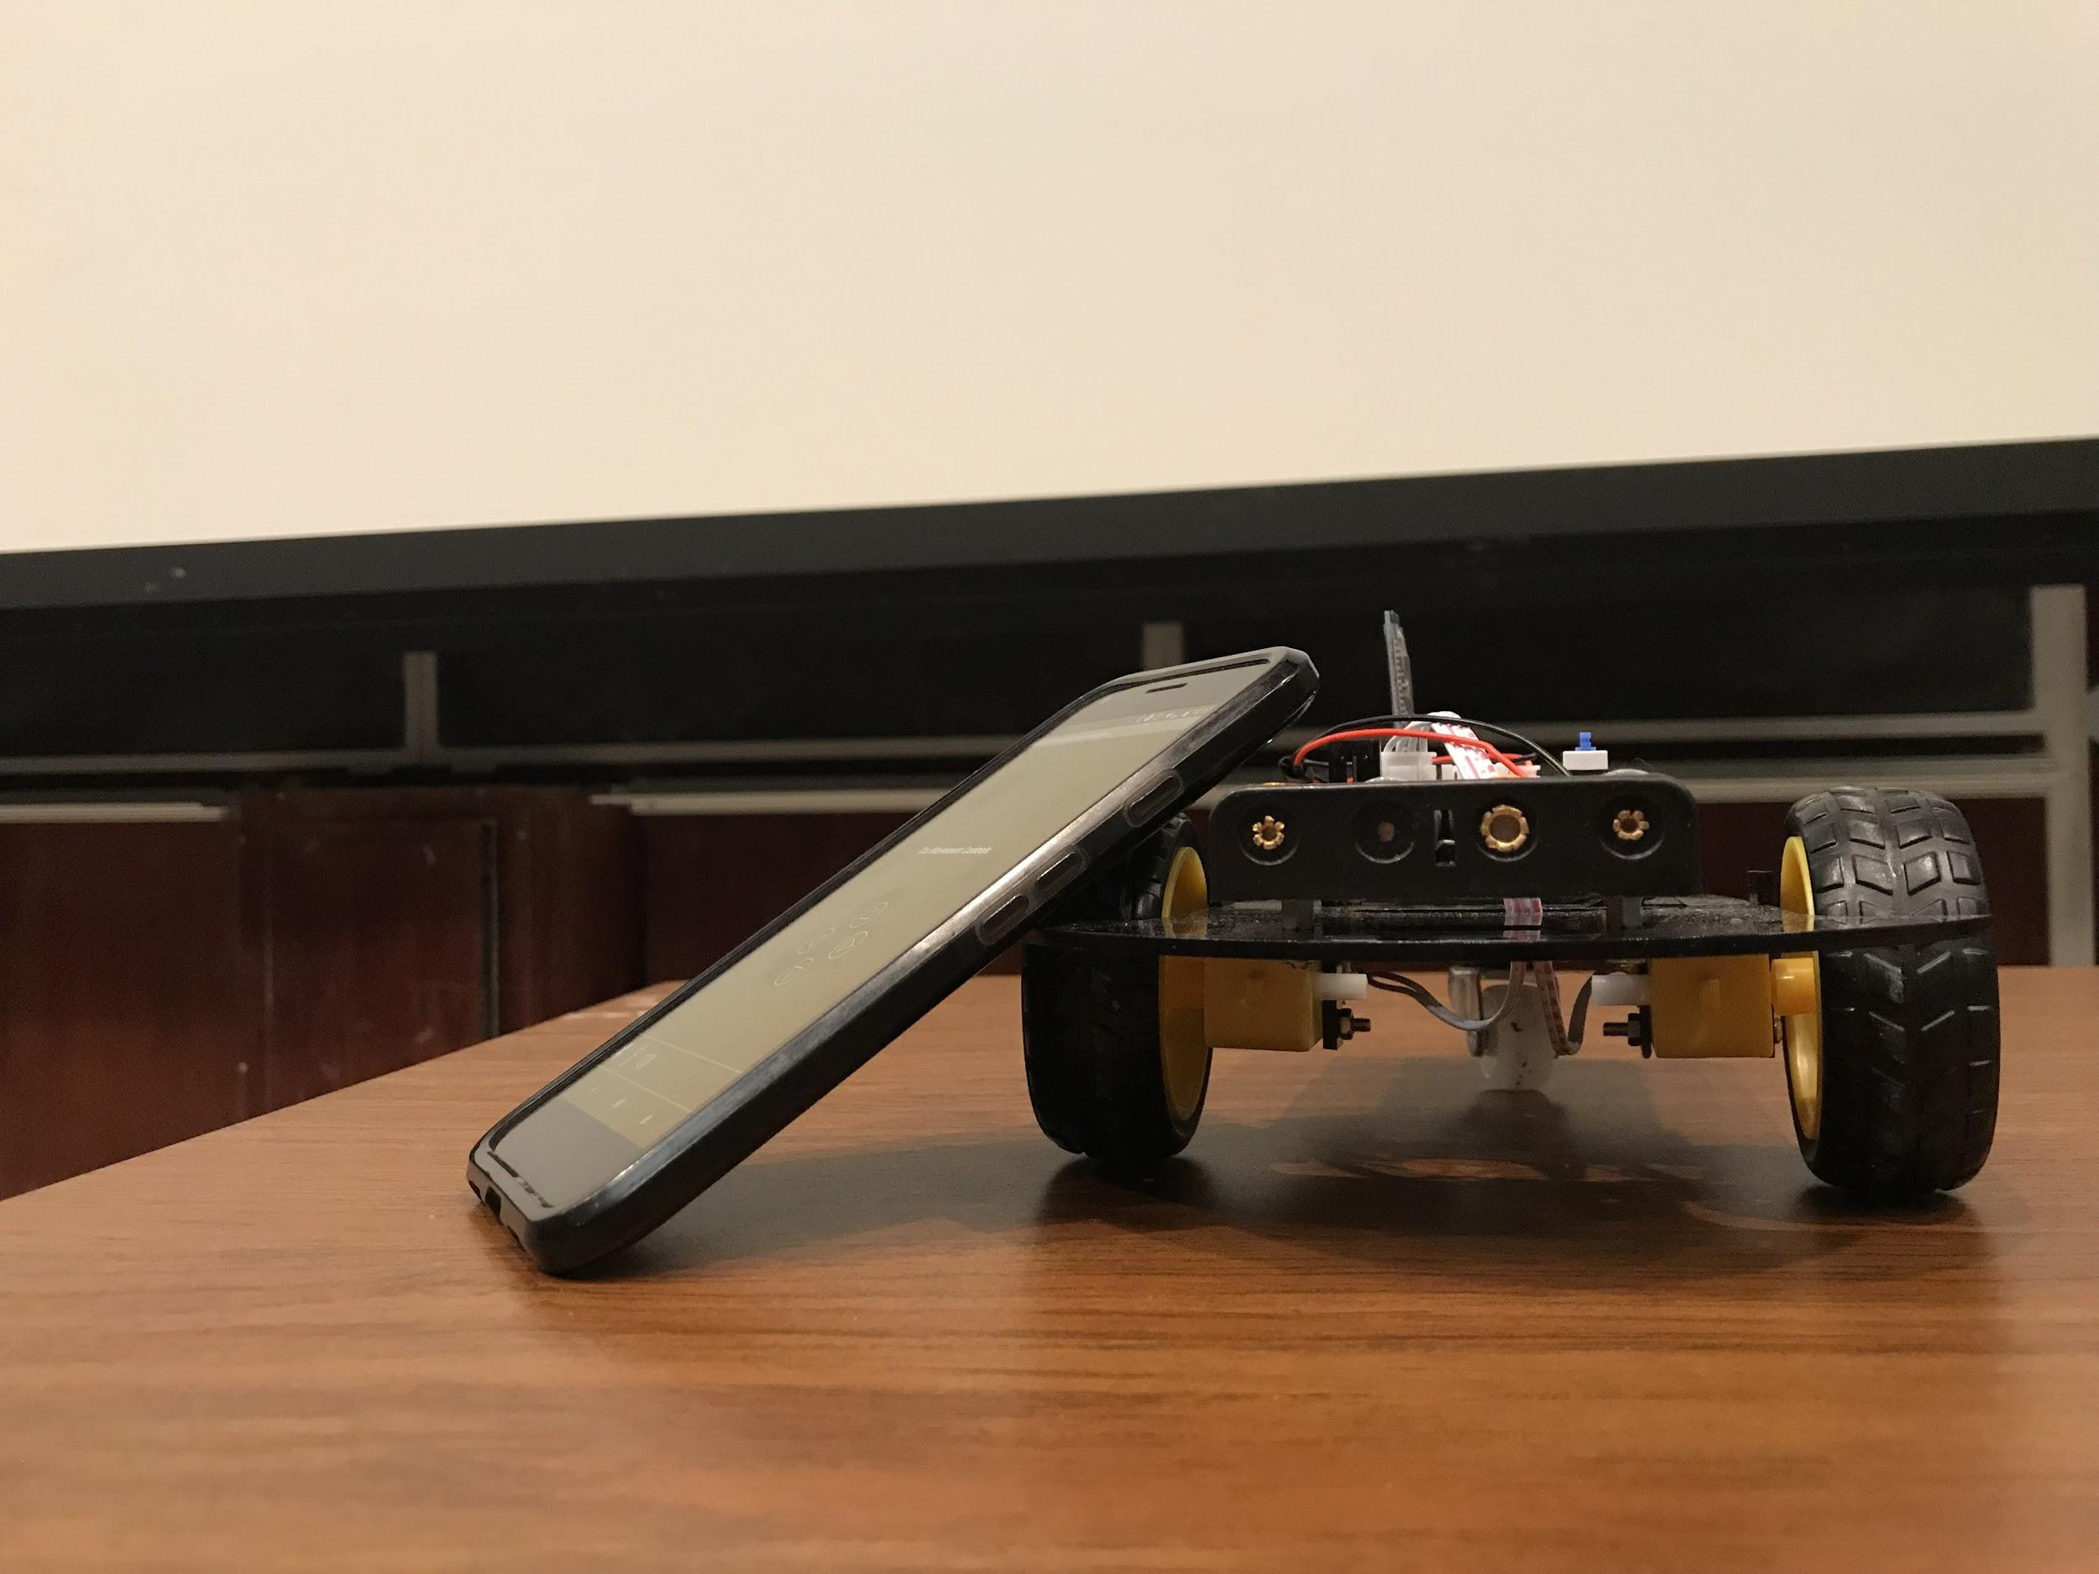
Photos Of Our Car
Notes:
David

Slide 11
Bill Of Materials
Item | Price | Vendor | Part Number | Link
UCTRONICS Smart Robot Car Kit for Arduino | $36.99 | amazon.com/UCTRONICS | K0069 | https://www.amazon.com/dp/B076MB5VH8/ref=psdc_3015426011_t3_B076M7JM8R
App Inventor 2: Create Your Own Android Apps | $22.51 (we got it for free) | Barnes & Noble | 9781491906842 | https://www.amazon.com/gp/product/1491906847/ref=ox_sc_act_title_1?smid=ATVPDKIKX0DER&psc=1
DSD TECH HC-06 Bluetooth 2.0 SPP Wireless BT Module for Arduino UNO R3 Nano MEGA Raspberry Pi (DIP Version) | $7.99 | DSD TECH Direct | B06Y31M847 | https://www.amazon.com/DSD-TECH-HC-06-Bluetooth-Raspberry/dp/B06Y31M847/ref=sr_1_3?s=books&ie=UTF8&qid=1527808512&sr=8-3&keywords=SH_BT_Board
Notes:
Nick Bruce - How we chose the parts
Originally we had the uno and the stepper motors but the difficulty in finding wheels as well as the slow speed led to us deciding to use a car kit. This came with a chassis, wheels, DC motors, as well as range finders which we found out we did not need.

Slide 12
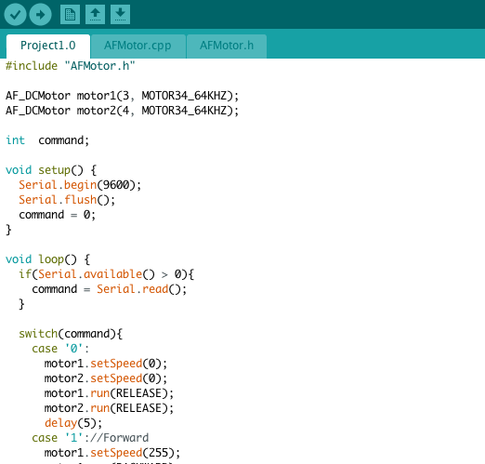
Arduino Implementation
Use of the AFMotor Library
Main logic uses a switch statement
Issues:
Getting motors to turn
Minimizing sound from motors
Connecting to Android phone
Notes:
Nathan

Slide 13
Demo

Slide 14

Thank You For Your Time!

